Slide 1
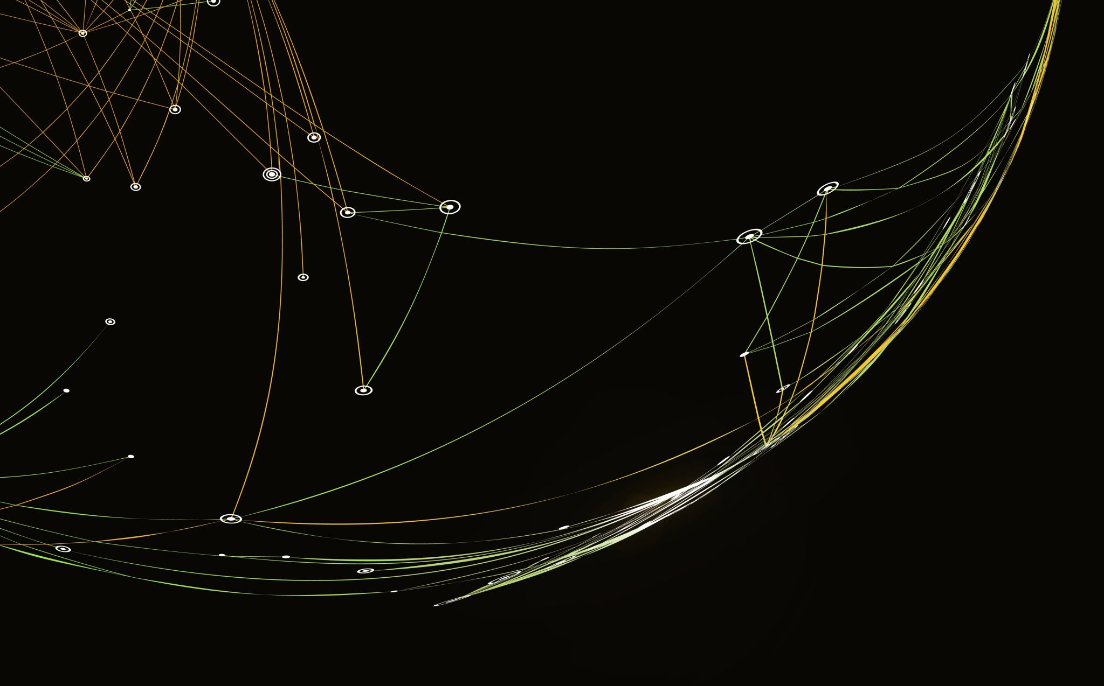

Tim Hortons Simulation
Wahaj Siddiqui

Slide 2
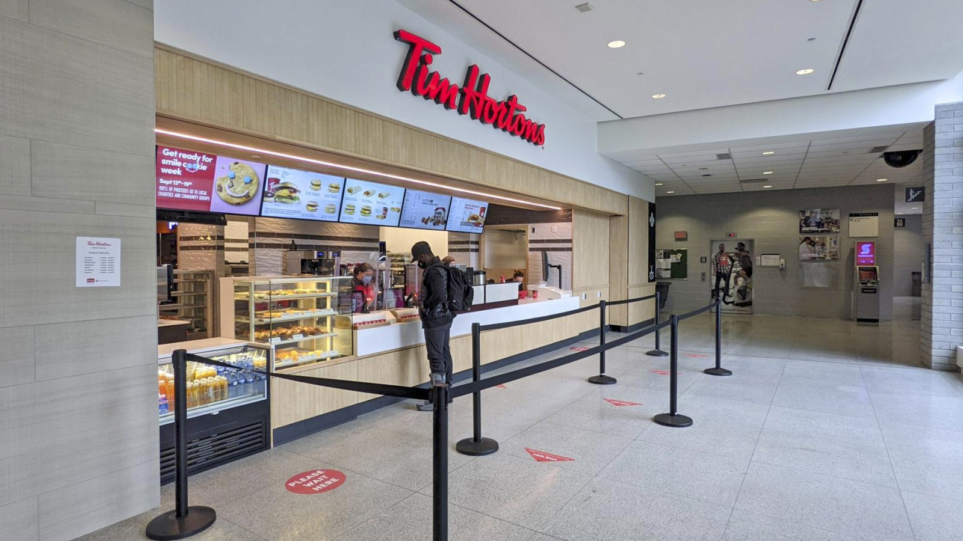
Current Problems
Not meeting service time goals during peak hours
7 minutes in system, 90 seconds process time
Increased waiting and service time
Negatively impacting customer experience
Increase in leaving queue or "balking"
Cashier bottlenecking
Canada Games
3G Capital
Dudley, K. (2019). Mobile Order. photograph, St. Catherines

Slide 3
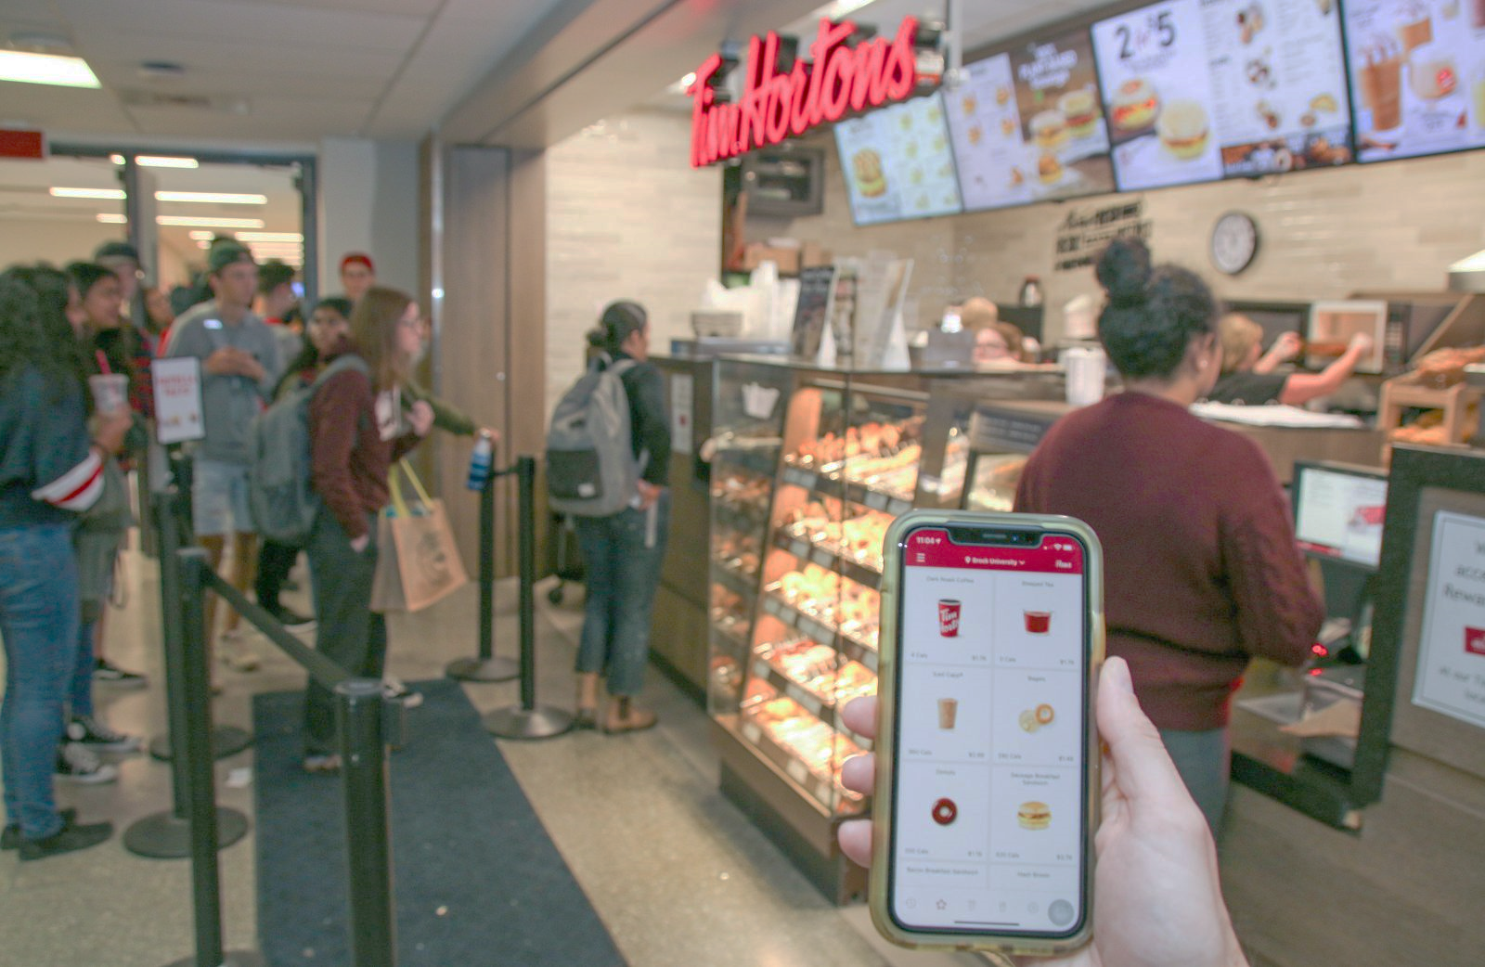
Objectives
Maximizing server utilization while avoiding overstaffing
Measure and reduce length of queue through different methods of ordering
Goal average time from order to pick-up is 90s
Determine areas of potential growth in this process
==> ensure one way traffic, limit congestion, resource efficiency, enhance student experience.
Dudley, K. (2019). Mobile Order. photograph, St. Catherines

Slide 4
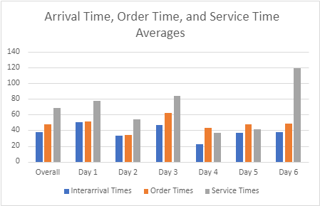

Data Analysis
Simplified and consolidated data for walk-in customers and mobile orders across 6 days and 7 days respectively
Organized data based on arrival times, order times, and service times.
Calculated the average arrival time, order time, service time, and balk rate of customers.
Input averages for walk-in customers and mobile order customers into Arena’s Input Analyzer
Obtained statistically significant data from the Input Analyzer and used the best distributions to formulate our expressions for our Arena model

Slide 5
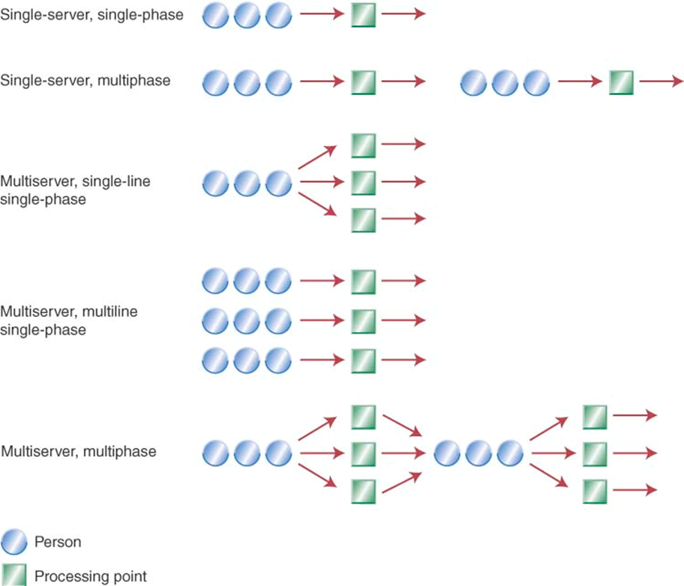
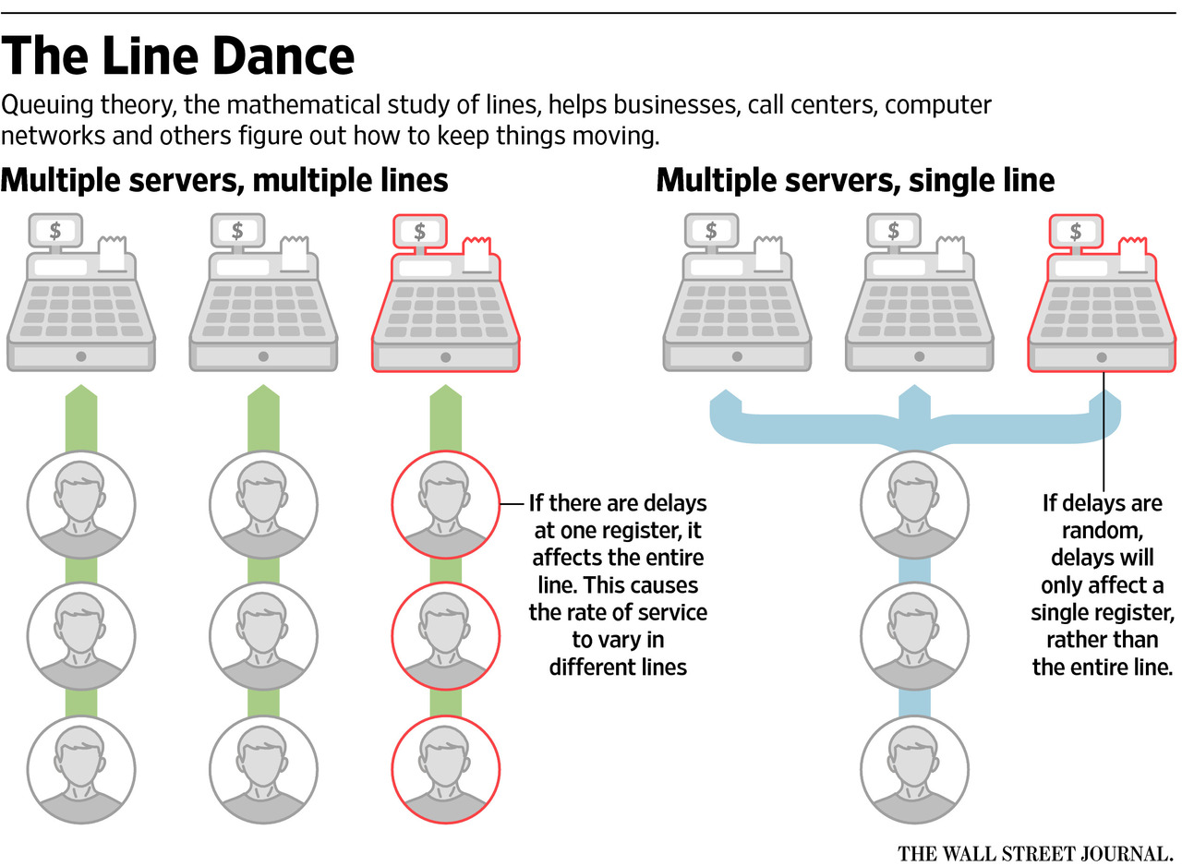
System and Methodology
System is a FCFS basis with 2 cash registers and a single queue.
Customers are either walk-in or mobile orders
Staffed with 3 to 5 workers depending on time of day and demand
Based on the data that was provided to us we believed that the average was the best method to use for arrival times, order times, and service times
These averages provided us with statistically significant data which enabled us to formulate our model of the system

Slide 6
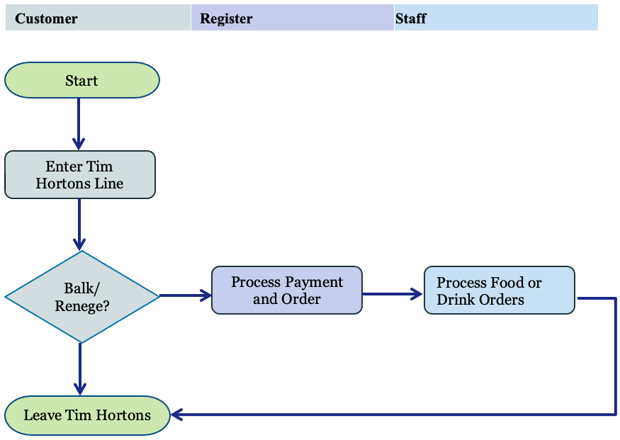

Arena Model Assumptions
Customers arrive one at a time and processed throughout the model individually
If customers balk or renege, they will be recorded as “customers balked”
System will assess level of demand based on the three hours of the system at HB
Customers recorded once regardless of if they return
Customers will leave instantaneously
System is initially idle and empty
Model is set for during the weekday
Follow a first ordered first served discipline

Slide 7
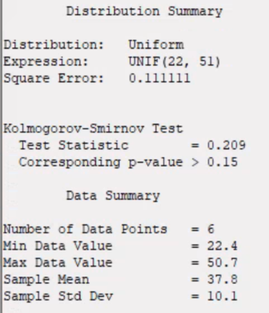
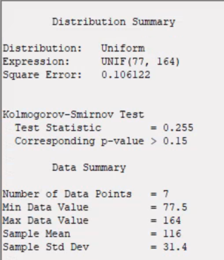
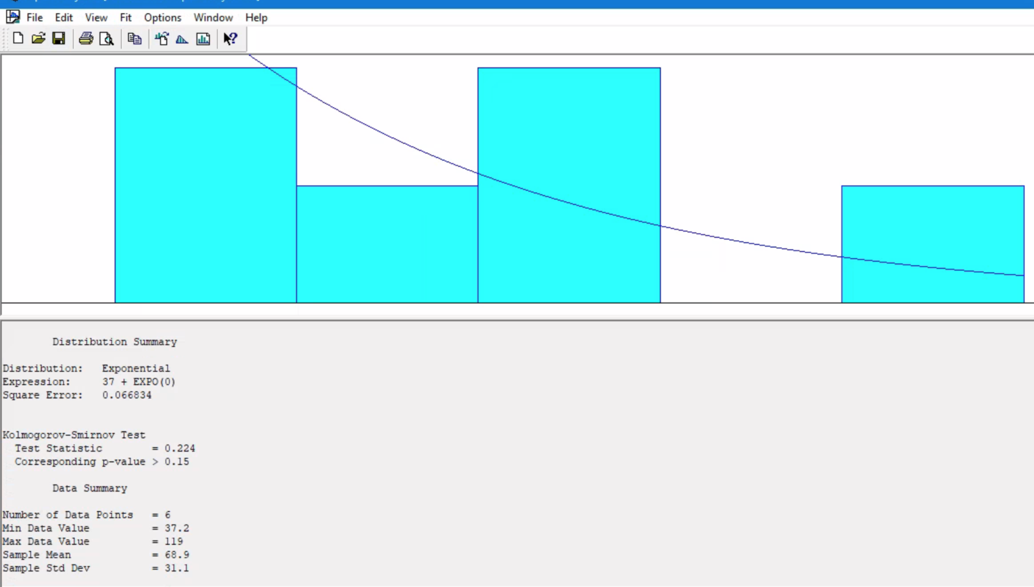
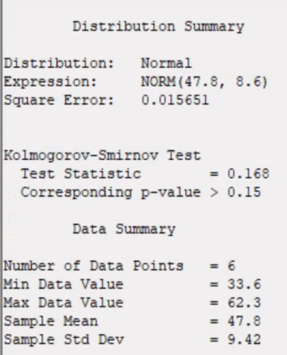
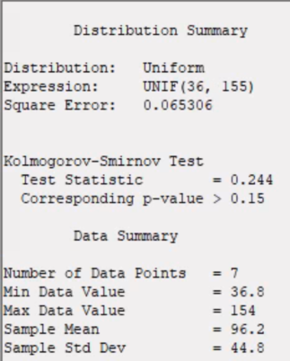
Model Expressions
Description for model
Interarrival:
Walk-in: UNIF (22,51)
Mobile: UNIF (77, 164)
Services:
Mobile Order Service: UNIF (36, 155)
Process Order & Payment: NORM (47.8, 8.6)
Order Process Service: EXPO (31.9)
Decision Module
2-way by chance
95% true with only 5% customers balking

Slide 8
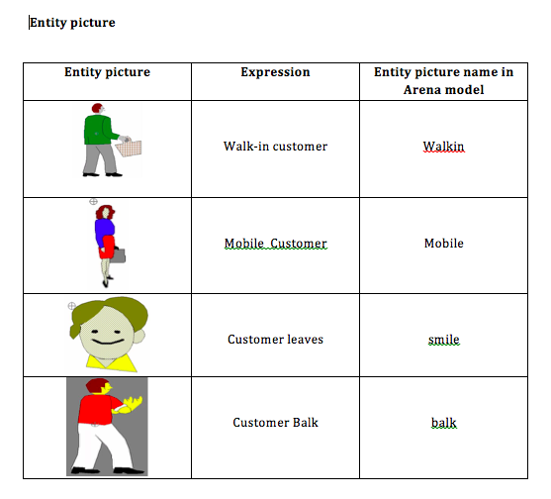
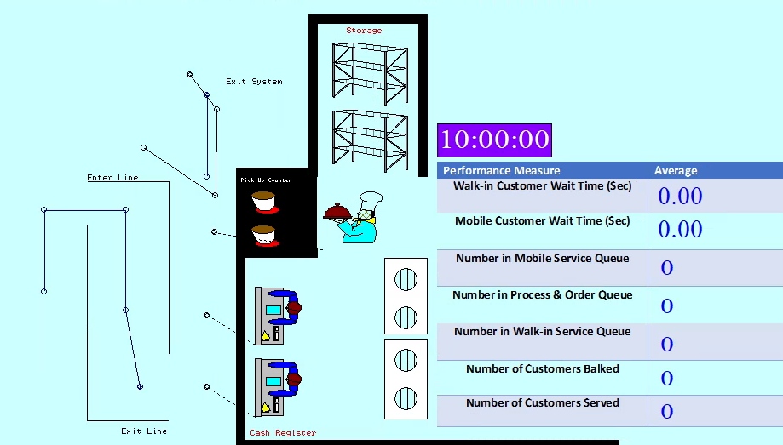
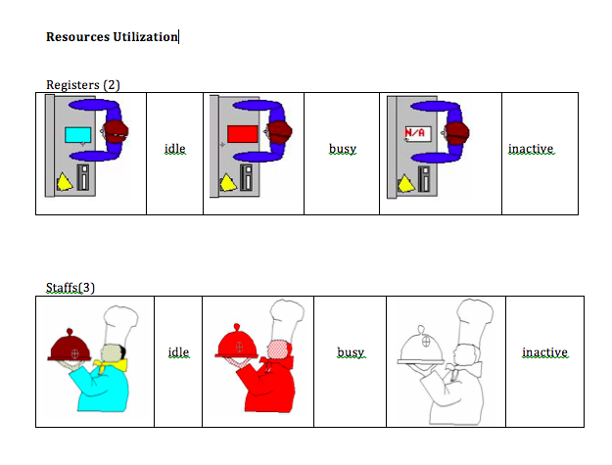
Model Animation

Slide 9
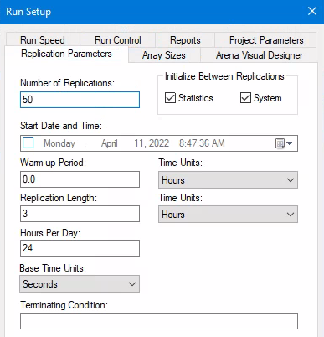
Arena Model Paramaters
Run Model
Run 50 replications, the length for replication is 3 hours , hours per day is 24, Base time units is Seconds

Slide 10
Result Analysis
​ Experiment​ | Average​ | Half-width​ | Min​ | Max​ | Min Average​ | Max Average​
Number of customers served​ | 352.10​ | 2.41 | ​ | ​ | 335.00​ | 367.00​
Time Mobile customers spend in the system​ (sec) | 95.9596​ | 0.98​ | 35.0267 | 188.70​ | 89.4686 | 105.66​
Time Walk-in customers spend in the system​ (sec) | 434.03 | 58.88 | 0.00 | 1950.83 | 153.94 | 1186.55
Time Walk-in customers spend waiting in line​ (sec) | 358.99 | 58.33​ | 0.00​ | 1865.14 | 82.0810 | 1107.39
Number in Process Order and Payment Queue ​ | 4.9774 | 0.81 | 0.00​ | 27.0000 | 1.1140 | 15.2141​
Number in Process Service Time Queue​ | 4.8642 | 0.76​ | 0.00​ | 27.0000​ | 1.1120 | 14.3764​
Number in Mobile Order Service | 0.0029 | 0.00 | 0.00 | 1.0000 | 0.00 | 0.0068
Number of Mobile customers in process​ | 0.8015 | 0.01​ | 0.00​ | 2.0000​ | 0.7407​ | 0.8805​
Number of Walk-in Customers in process​ | 11.8107 | 1.58​ | 0.00​ | 51.0000​ | 4.1571​ | 31.5818​
Utilization of Staff​ | 0.2212​ | 0.00​ | 0.00​ | 0.8000​ | 0.2100​ | 0.2286​
Utilization of Register​ | 0.9859 | 0.00​ | 0.00​ | 1.0000​ | 0.9284 | 1.0000​
Customer Balks/Renege​ | 14.7000 | 1.08​ | ​ | ​ | 9.0000 | 28.0000​
Takes utilization (Number Busy/Number Scheduled) at each instant in time and calculated a time-weighted average

Slide 11
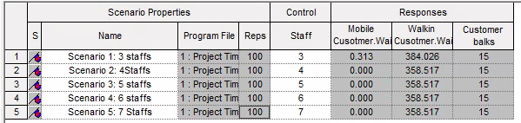
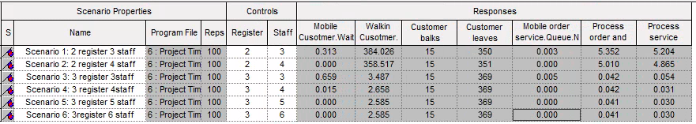
Experiments
Experiment 1
Objective: measure significance in change after adding additional staff member
100 replications
Play for Experiment 1
Experiment 2
Objective: measure significance in change after adding additional cashier resource to system
100 replications
Play for Experiment 2

Slide 12
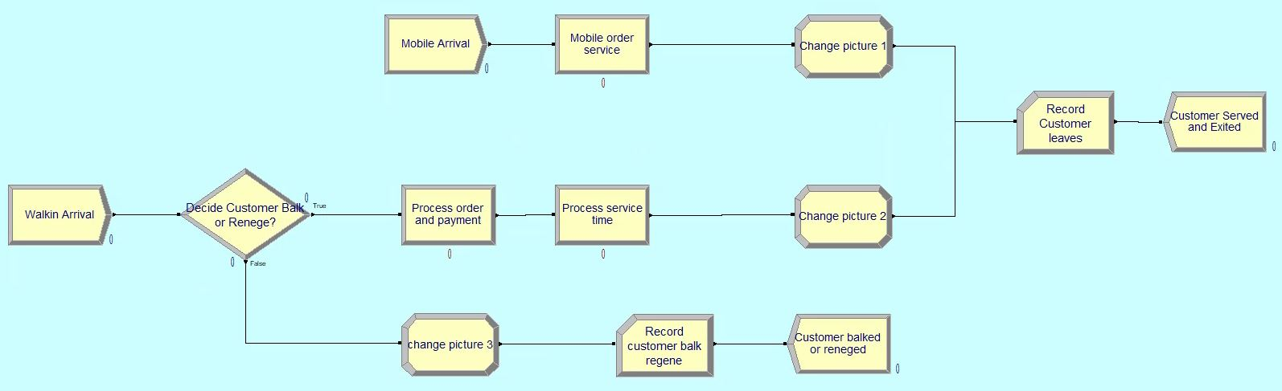
Recommendations
Additional register to system during peak hours
Revenue generated during three-hour time period is $5,781 (roughly)
Additional staff member for Canada Games
Assist with increased demand
Improve training personnel to strengthen service and utilization rate
Enhance student experience
Incentivize mobile ordering
Perks such as reward points and promotions

